Slide 1



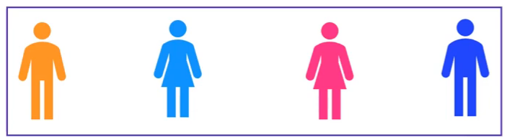

Explainable Artificial Intelligence for Diabetes Prediction
Shapley Values
Team
Contribution
GAME
PAYOUT

Slide 2

Explainable Artificial Intelligence for Diabetes Prediction
Shapley Values
Team
Contribution
$
GAME
PAYOUT

Slide 3

Explainable Artificial Intelligence for Diabetes Prediction
Shapley Values
Team
What is a fair distribution?
Contribution
$
GAME
PAYOUT

Slide 4
Explainable Artificial Intelligence for Diabetes Prediction
Shapley Values
Team
What is a fair distribution?
SHAPLEY VALUES
Lloyd Shapley
(1953)
Contribution
$
GAME
PAYOUT

Slide 5
Explainable Artificial Intelligence for Diabetes Prediction
Shapley Values
Team
What is a fair distribution?
SHAPLEY VALUES
AGE
GENDER
BMI
STROKE
Lloyd Shapley
(1953)
Contribution
$
GAME
PAYOUT

Slide 6
Explainable Artificial Intelligence for Diabetes Prediction
Shapley Values
Team
What is a fair distribution?
SHAPLEY VALUES
AGE
GENDER
BMI
STROKE
Contribution
ML
BLACK BOX MODEL
$
PAYOUT

Slide 7
Explainable Artificial Intelligence for Diabetes Prediction
Shapley Values
Team
What is a fair distribution?
SHAPLEY VALUES
AGE
GENDER
BMI
STROKE
Lloyd Shapley
(1953)
Contribution
ML
BLACK BOX MODEL
$
PREDICTION

Slide 8

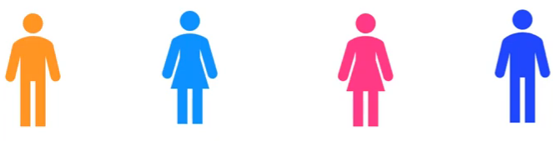




Explainable Artificial Intelligence for Diabetes Prediction
Shapley Values
Payout
10.000$
7.000$

Slide 9
Explainable Artificial Intelligence for Diabetes Prediction
Shapley Values
Payout
10.000$

Slide 10
Explainable Artificial Intelligence for Diabetes Prediction
Shapley Values
Payout
10.000$

Slide 11
Explainable Artificial Intelligence for Diabetes Prediction
Shapley Values
Marginal Contribution
3.000$
1.500$
2.500$
3.000$
Payout
10.000$

Slide 12
Explainable Artificial Intelligence for Diabetes Prediction
Shapley Values
If we have a coalition C that collaborates to produce a value V
How much did each individual member contribute to the final value?

Slide 13
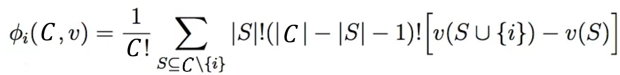

Explainable Artificial Intelligence for Diabetes Prediction
Shapley Values

Slide 14

Explainable Artificial Intelligence for Diabetes Prediction
Shapley Values

Slide 15
Explainable Artificial Intelligence for Diabetes Prediction
Shapley Values

Slide 16
Explainable Artificial Intelligence for Diabetes Prediction
Shapley Values

Slide 17
Explainable Artificial Intelligence for Diabetes Prediction
Shapley Values

Slide 18
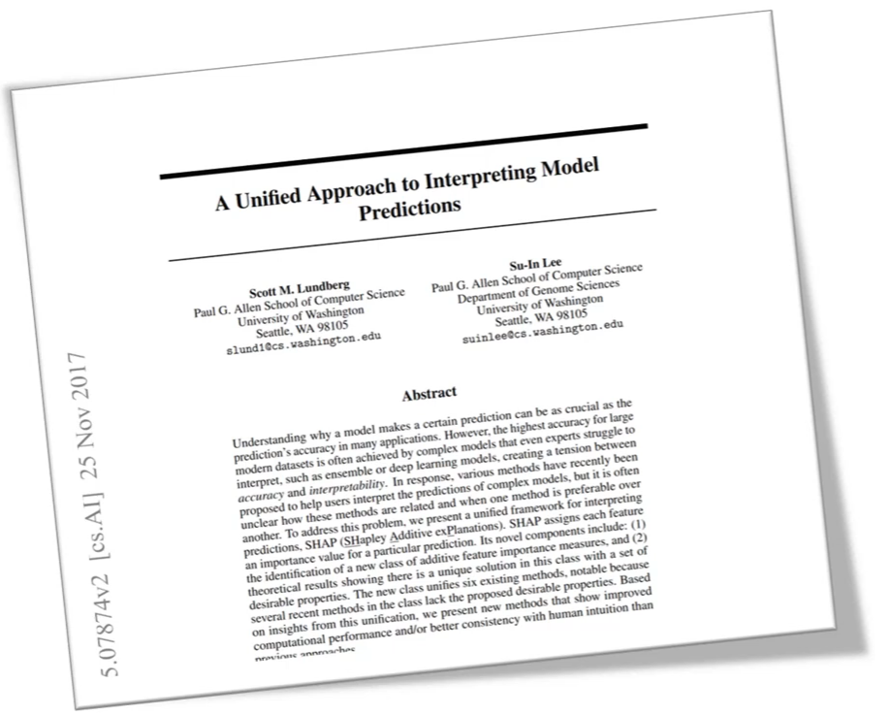

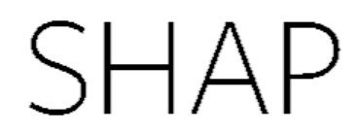
Explainable Artificial Intelligence for Diabetes Prediction
SHapley Additive exPlanations

Slide 19




Explainable Artificial Intelligence for Diabetes Prediction
Calculating Shapley Values
$$1$$
$$2$$
$$3$$
$$4$$
C
V

Slide 20



Explainable Artificial Intelligence for Diabetes Prediction
Calculating Shapley Values
$$x_{1}$$
$$x_{2}$$
$$x_{4}$$
$$x_{4}$$
x
f(x)

Slide 21
Explainable Artificial Intelligence for Diabetes Prediction
Shapley Additive explanations

Slide 22
Explainable Artificial Intelligence for Diabetes Prediction
Shapley Additive explanations

Slide 23

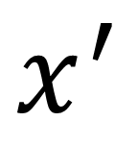
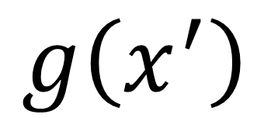
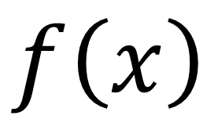


Explainable Artificial Intelligence for Diabetes Prediction
Additive feature attribution methods
$$x$$
$$≈$$
$$x^{′}$$
SIMPLIFIED LOCAL INPUTS
INPUTS
$$f\left(x\right)$$
$$≈$$
$$g\left(x^{′}\right)$$
MODEL
EXPLANATORY
MODEL

Slide 24
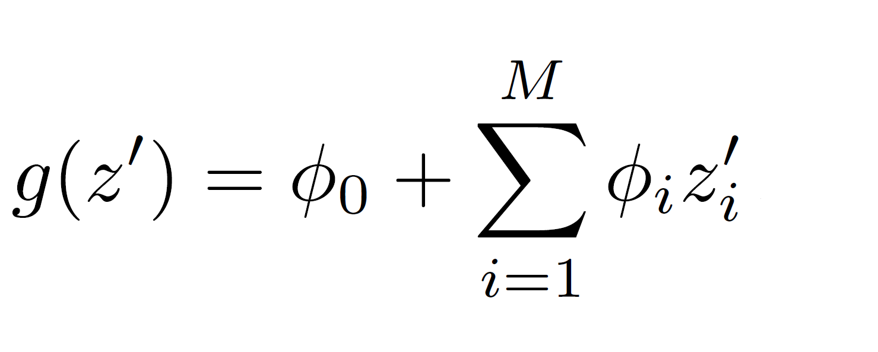
Explainable Artificial Intelligence for Diabetes Prediction
Additive feature attribution methods
FEATURE EFFECT

Slide 25
Explainable Artificial Intelligence for Diabetes Prediction
Additive feature attribution methods
ADDITIVE FEATURE ATTRIBUTION

Slide 26
LOCAL ACCURACY

Slide 27
LOCAL ACCURACY
MISSINGNESS

Slide 28
LOCAL ACCURACY
MISSINGNESS
CONSISTENCY

Slide 29
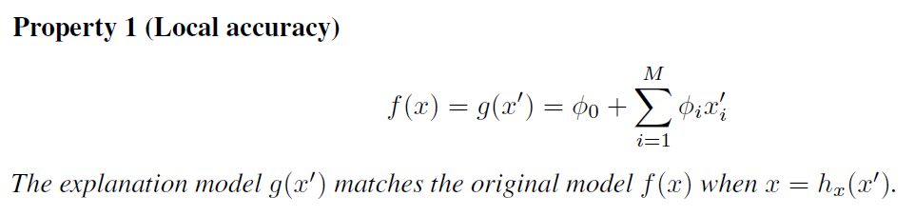
Explainable Artificial Intelligence for Diabetes Prediction
Simple Properties Uniquely Determine Additive Feature Attributions

Slide 30
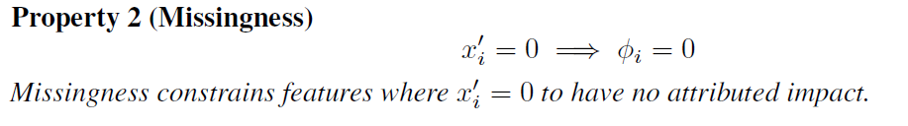
Explainable Artificial Intelligence for Diabetes Prediction
Simple Properties Uniquely Determine Additive Feature Attributions

Slide 31
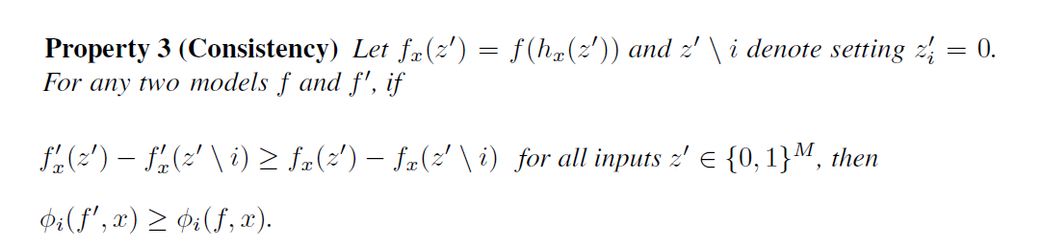
Explainable Artificial Intelligence for Diabetes Prediction
Simple Properties Uniquely Determine Additive Feature Attributions

Slide 32
Explainable Artificial Intelligence for Diabetes Prediction
Additive feature attribution methods

Slide 33
Explainable Artificial Intelligence for Diabetes Prediction
Additive feature attribution methods
SHAPLEY VALUES

Slide 34
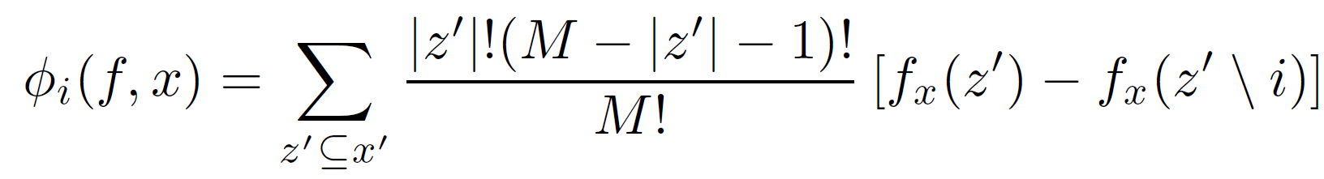
Explainable Artificial Intelligence for Diabetes Prediction
Calculating Shapley Values
Shapley value
for feature i

Slide 35
Explainable Artificial Intelligence for Diabetes Prediction
Calculating Shapley Values
AGE
Shapley value
for feature i

Slide 36
Explainable Artificial Intelligence for Diabetes Prediction
Calculating Shapley Values
Black Box model
AGE
Shapley value
for feature i

Slide 37
Explainable Artificial Intelligence for Diabetes Prediction
Calculating Shapley Values
Black Box model
Input data point
AGE
Shapley value
for feature i

Slide 38
Explainable Artificial Intelligence for Diabetes Prediction
Calculating Shapley Values
Black Box model
Input data point
AGE
Shapley value
for feature i

Slide 39
Explainable Artificial Intelligence for Diabetes Prediction
Calculating Shapley Values
Black Box model
Input data point
AGE
Shapley value
for feature i

Slide 40
Explainable Artificial Intelligence for Diabetes Prediction
Calculating Shapley Values
Black Box model
Input data point
AGE
Shapley value
for feature i
Subset

Slide 41
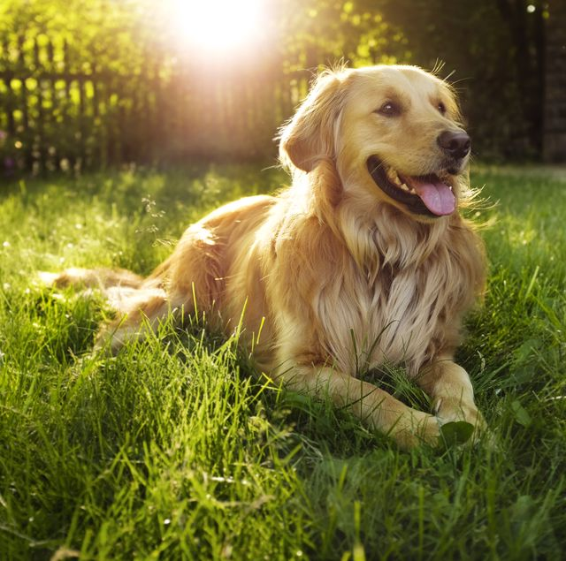
Explainable Artificial Intelligence for Diabetes Prediction
Calculating Shapley Values
Black Box model
Input data point
AGE
Shapley value
for feature i
Subset

Slide 42
Explainable Artificial Intelligence for Diabetes Prediction
Calculating Shapley Values
Black Box model
Input data point
AGE
Shapley value
for feature i
Simplified data input
Subset

Slide 43


Explainable Artificial Intelligence for Diabetes Prediction
Calculating Shapley Values
Black Box model
Input data point
AGE
Shapley value
for feature i
Simplified data input
Subset

Slide 44
Explainable Artificial Intelligence for Diabetes Prediction
Calculating Shapley Values
Black Box model
Input data point
AGE
Shapley value
for feature i
Simplified data input
Subset

Slide 45
Explainable Artificial Intelligence for Diabetes Prediction
Calculating Shapley Values
Black Box model
Input data point
AGE
Shapley value
for feature i
Simplified data input
Subset

Slide 46


Explainable Artificial Intelligence for Diabetes Prediction
Calculating Shapley Values
Black Box model
Input data point
AGE
Shapley value
for feature i
Simplified data input
Subset

Slide 47
Explainable Artificial Intelligence for Diabetes Prediction
Calculating Shapley Values
Black Box model
Input data point
AGE
70% stroke
Shapley value
for feature i
Simplified data input
Subset

Slide 48
Explainable Artificial Intelligence for Diabetes Prediction
Calculating Shapley Values
Black Box model
Input data point
10% stroke
AGE
Shapley value
for feature i
Simplified data input
Subset

Slide 49
Explainable Artificial Intelligence for Diabetes Prediction
Calculating Shapley Values
Black Box model
Input data point
AGE
Shapley value
for feature i
Simplified data input
Weighting
Subset

Slide 50
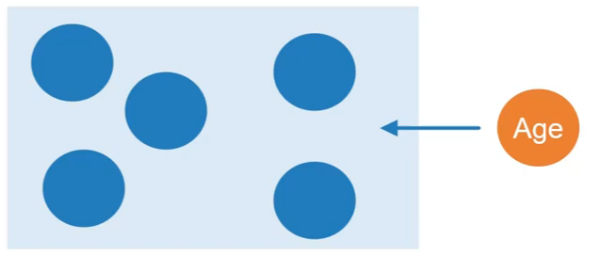
Explainable Artificial Intelligence for Diabetes Prediction
Calculating Shapley Values
Black Box model
Input data point
AGE
Shapley value
for feature i
Simplified data input
Weighting
Contribution
Subset

Slide 51
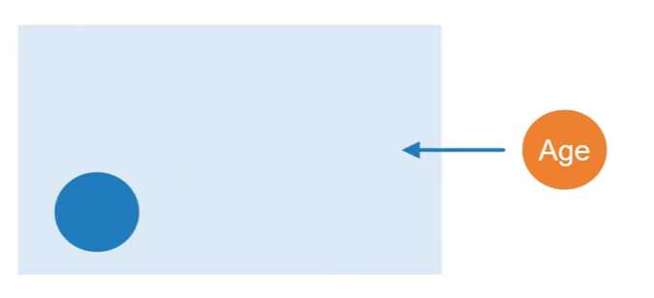
Explainable Artificial Intelligence for Diabetes Prediction
Calculating Shapley Values
Black Box model
Input data point
AGE
Shapley value
for feature i
Simplified data input
Weighting
Contribution
Subset

Slide 52
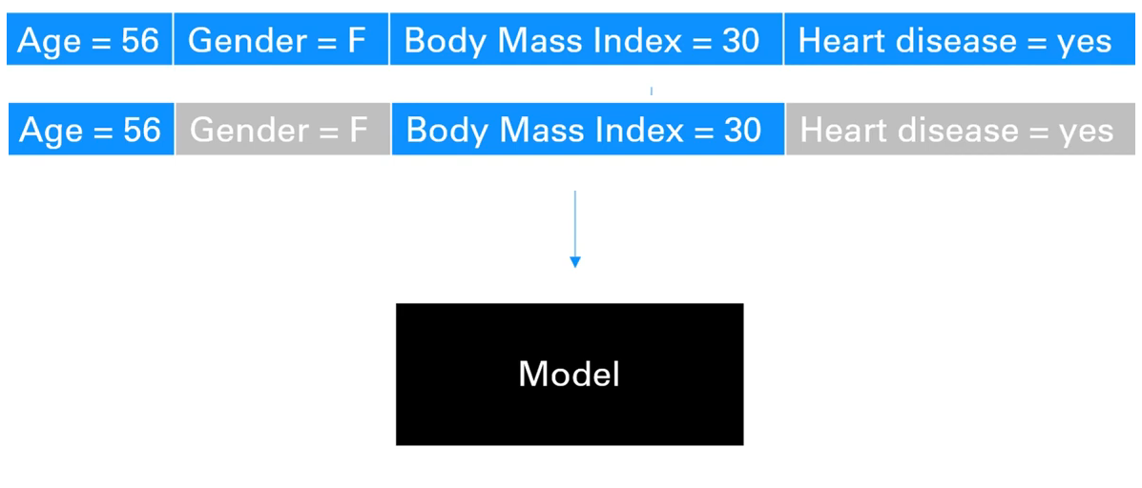
Explainable Artificial Intelligence for Diabetes Prediction
SHAP: Shapley Kernel
SUBSET
?

Slide 53

Explainable Artificial Intelligence for Diabetes Prediction
SHAP: Shapley Kernel
SUBSET

Slide 54
Explainable Artificial Intelligence for Diabetes Prediction
Additive feature attribution methods

Slide 55
Explainable Artificial Intelligence for Diabetes Prediction
Additive feature attribution methods
$$2^{n}=total number of subsets of a set of size n$$

Slide 56
Explainable Artificial Intelligence for Diabetes Prediction
Additive feature attribution methods
$$2^{n}=total number of subsets of a set of size n$$
4 Features: 64 total coalitions to sample

Slide 57
Explainable Artificial Intelligence for Diabetes Prediction
Additive feature attribution methods
$$2^{n}=total number of subsets of a set of size n$$
4 Features: 64 total coalitions to sample
32 Features: 17.1 billion

Slide 58
Explainable Artificial Intelligence for Diabetes Prediction
Shapley Kernel

Slide 59
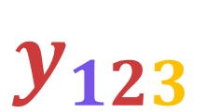
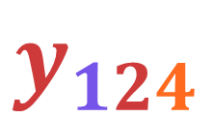
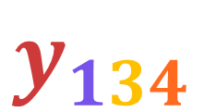
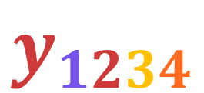
Explainable Artificial Intelligence for Diabetes Prediction
SHAP: Shapley Kernel
$$y_{1234}$$
$$y_{134}$$
$$y_{124}$$
$$y_{123}$$

Slide 60
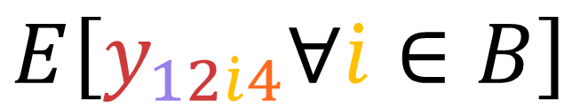
Explainable Artificial Intelligence for Diabetes Prediction
SHAP: Shapley Kernel
Included features
$$E\left[y_{12\dot{i}4}∀\dot{i}∈B\right]$$
Values from a background B

Slide 61
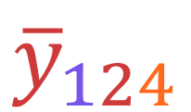
Explainable Artificial Intelligence for Diabetes Prediction
SHAP: Shapley Kernel
Included features
$${\overline{y}}_{124}$$
Values from a background B

Slide 62
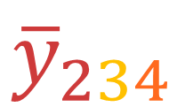
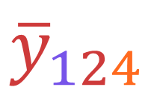
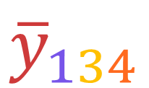
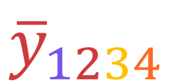
Explainable Artificial Intelligence for Diabetes Prediction
SHAP: Shapley Kernel
$${\overline{y}}_{1234}$$
$${\overline{y}}_{134}$$
$${\overline{y}}_{124}$$
$${\overline{y}}_{234}$$

Slide 63





Explainable Artificial Intelligence for Diabetes Prediction
SHAP: Shapley Kernel
$$c_{1}$$
$${\overline{y}}_{1234}$$
$$c_{2}$$
$${\overline{y}}_{134}$$
$$=$$
$$c_{3}$$
$${\overline{y}}_{124}$$
$$c_{4}$$
$${\overline{y}}_{234}$$

Slide 64




Explainable Artificial Intelligence for Diabetes Prediction
SHAP: Shapley Kernel
$$φ_{1}$$
$${\overline{y}}_{1234}$$
$$φ_{1}$$
$${\overline{y}}_{134}$$
$$=$$
$$φ_{1}$$
$${\overline{y}}_{124}$$
$$φ_{1}$$
$${\overline{y}}_{234}$$

Slide 65
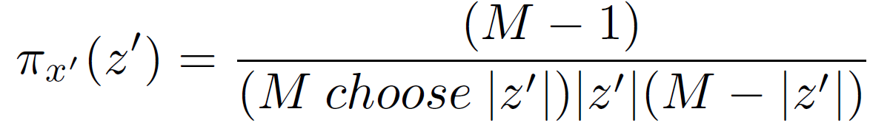
Explainable Artificial Intelligence for Diabetes Prediction
SHAP: Shapley Kernel
$$w_{C}= \frac{\# total features −1}{\#(\begin{aligned}\#\#\# coalitions \\ of size \left|C\right|\end{aligned})·\# (\begin{aligned}\#\#\# included \\ features in C\end{aligned})·\# (\begin{aligned}\#\#\# excluded \\ features in C\end{aligned})}$$

Slide 66
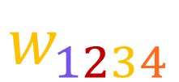
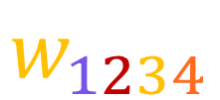
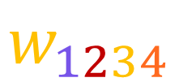

Explainable Artificial Intelligence for Diabetes Prediction
SHAP: Shapley Kernel
$$φ_{1}$$
$${\overline{y}}_{1234}$$
$$w_{1234}$$
$$φ_{1}$$
$${\overline{y}}_{134}$$
$$w_{1234}$$
$$=$$
$$φ_{1}$$
$${\overline{y}}_{124}$$
$$w_{1234}$$
$$φ_{1}$$
$${\overline{y}}_{234}$$
$$w_{1234}$$

Slide 67
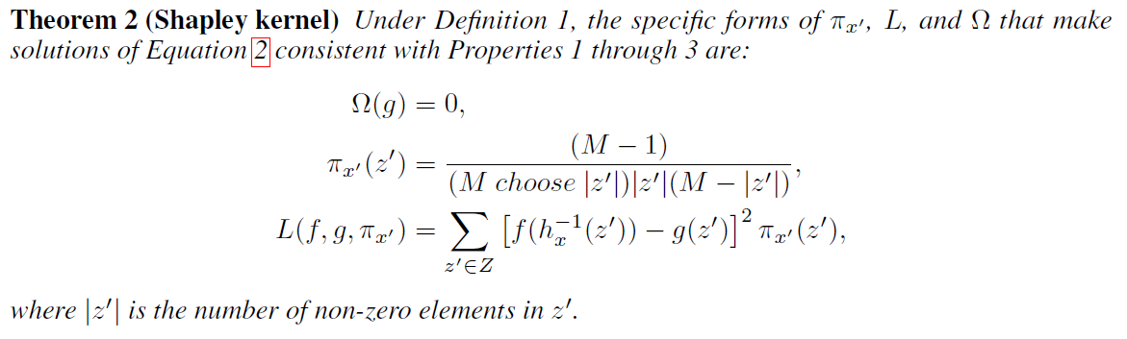
Explainable Artificial Intelligence for Diabetes Prediction
SHAP: Shapley Kernel
Kernel SHAP = LIME + SHAPLEY VALUES

Slide 68
Explainable Artificial Intelligence for Diabetes Prediction
SHAP: Model specific variants
Max SHAP
Low-order SHAP
Kernel SHAP
Linear SHAP
Tree SHAP
Deep SHAP

Slide 69
Explainable Artificial Intelligence for Diabetes Prediction
SHAP: Model specific variants
Max SHAP
Low-order SHAP
Kernel SHAP
Linear SHAP
Tree SHAP
Deep SHAP

Slide 70
Explainable Artificial Intelligence for Diabetes Prediction
Things that could be added to the project:
Deep SHAP
Tree SHAP
Weighted linear Regression
SHAP vs LIME looking at consistency in an example

